Slide 1
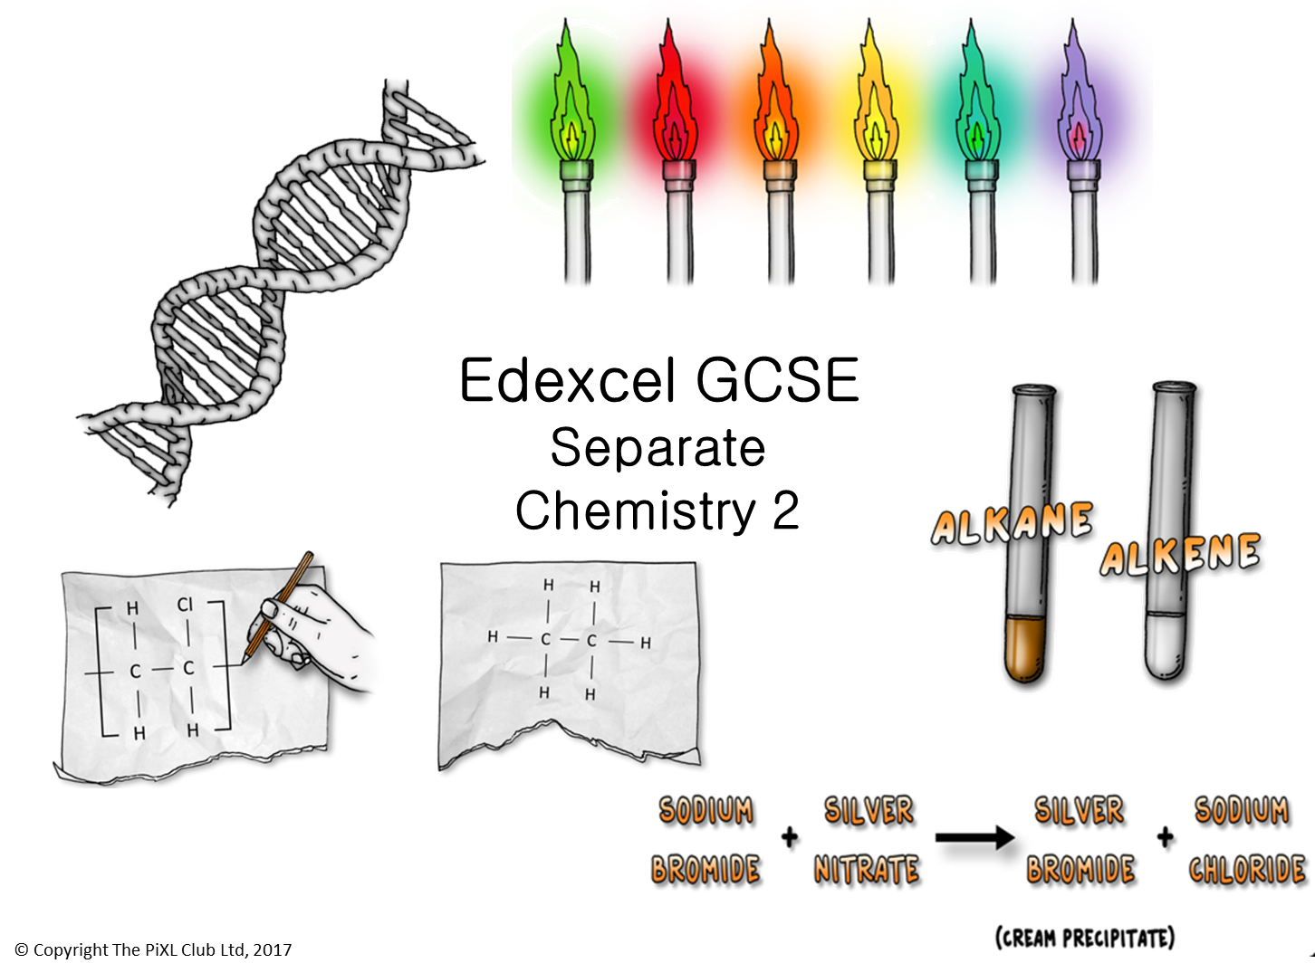

Slide 2
Alcohols:
Give the general formula of an alcohol?
Describe, using balanced symbol equations the difference between the reactions of ethanol and water with sodium.
Describe and explain the conditions required to convert glucose to ethanol by fermentation.
What are the uses of the first four alcohols?
Carboxylic acids (Chemistry only):
Draw the structural formula for ethanoic acid and explain what happens when it is added to sodium carbonate.
(HT only) Explain why ethanoic acid is described as a weak acid.
Describe the differences between propanol and propanoic acid
Name the chemical formed if propanol is reacted with propanoic acid.
Addition polymerisation:
Describe what happens during the polymerisation of ethene.
In this polymer, ethene is described as the repeating unit. Explain using a diagram what this means.
No atoms are lost from the monomers in addition polymerisation. Explain why this is the case.
Draw diagrams to show how the monomer chloroethene polymerises.
Alkanes and alkenes:
Name and draw the first four members of the alkanes.
Explain how alkanes and alkenes differ.
Describe, using structural formula, how bromine water can be used to test for an alkene. Give the colour change you would expect to see in the reaction.
Name and draw the structural formula of the alkene with five carbon atoms.
This alkene can have different structural formula explain why.
Non-metal ions:
A student adds silver nitrate solution to a sample of impure water a white precipitate is formed. When barium chloride is added another white precipitate is also formed. What ions are present in the water?
What are the balanced symbol equations for the above reactions.
A scientist believes that a sample of pure water is contaminated by sodium carbonate. Describe the two tests they can carry out to prove this.
Edexcel GCSE Separate Chemistry 2
ThinkIT!
© Copyright The PiXL Club Ltd, 2017
Condensation polymerisation:
Glycerine H₂NCH₂COOH polymerises by condensation polymerisation to form a polypeptide. Using the formula above, explain why this is an example of condensation polymerisation to make a polypeptide.
Explain how addition and condensation polymerisation differ?
Instrumental methods:
A student decides to use instrumental methods to determine which ions are present in a chemical sample. Why might this be an advantage in comparison to chemical methods?
Describe in detail how a scientist would evaluate data from a flame photometer to determine the concentration of ions in dilute solution and to identify metal ions.
Flame tests:
Describe how you would perform a flame test.
Give the flame test colours of three group 1 metals.
Explain why you might not get an orange-red flame when carrying out a flame test even though calcium ions are present.

